Slide 1
Design Methodologies Conference 2025 - Sponsorship
September 2020 – June 2021

Slide 2
Conference Topics
•The Design Methodologies Conference will have four thrusts in 2025
–Design Automation
–Cyber-Security Techniques
–AI / ML and Data Driven Techniques
–Measurement, Verification & Test Methods
•These thrusts align with the key themes of TC10
Further information will be made available through conference website: https://attend.ieee.org/dmc-2025

Slide 3
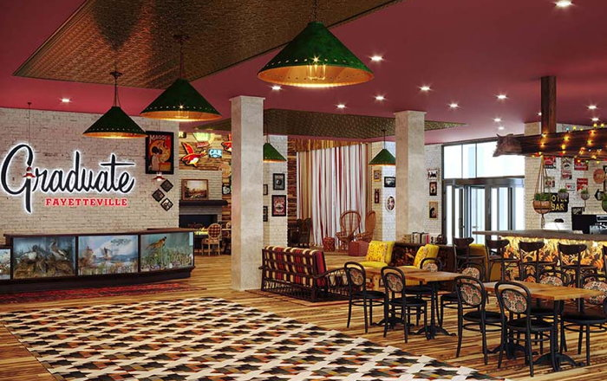
Conference Venue

Slide 4
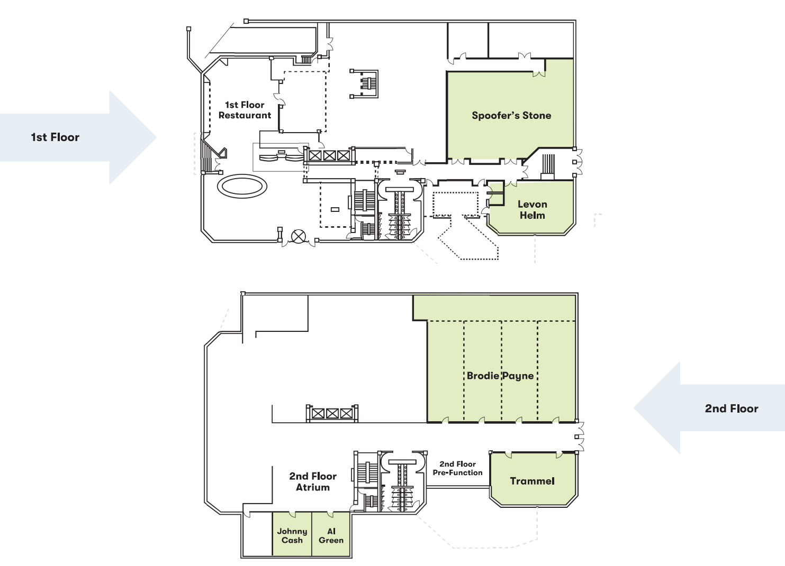
Conference Venue

Slide 5
Target Group
Approx. 100 attendees
Academia and Power Electronics Industry
Interested in Simulation, Test & Measurement, and the linkage of both

Slide 6
Packages
Platinum - $3,000
Exclusive sponsor of keynote
Two-minute company introduction during conference opening
Exclusive branded conference bag
Company logo and paragraph on website and in email blasts with link and in digital communications
Exhibition space 100 sq ft, two exhibition tables, four chairs and room for banners
Two complimentary conference registrations
Gold - $2,000
Exclusive sponsor of keynote
Company logo and paragraph on website and in email blasts with link and in digital communications
Exhibition space 80 sq ft, one exhibition table, two chairs and room for banners
One complimentary conference registration

Slide 7
Packages
Silver - $1,000
Company logo on website and in email blasts with link and in digital communications
Exhibition space 60 sq ft, one exhibition table, two chairs and room for banners
One complimentary conference registration
Bronze - $500
Company logo on website with link
Exhibition space 50 sq ft, one exhibition table, two chairs and room for banners
Company contact information in conference program

Slide 8
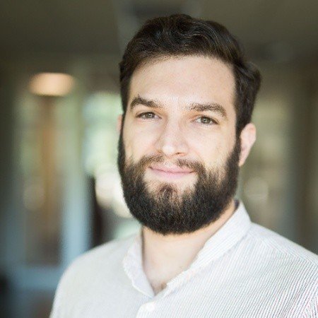
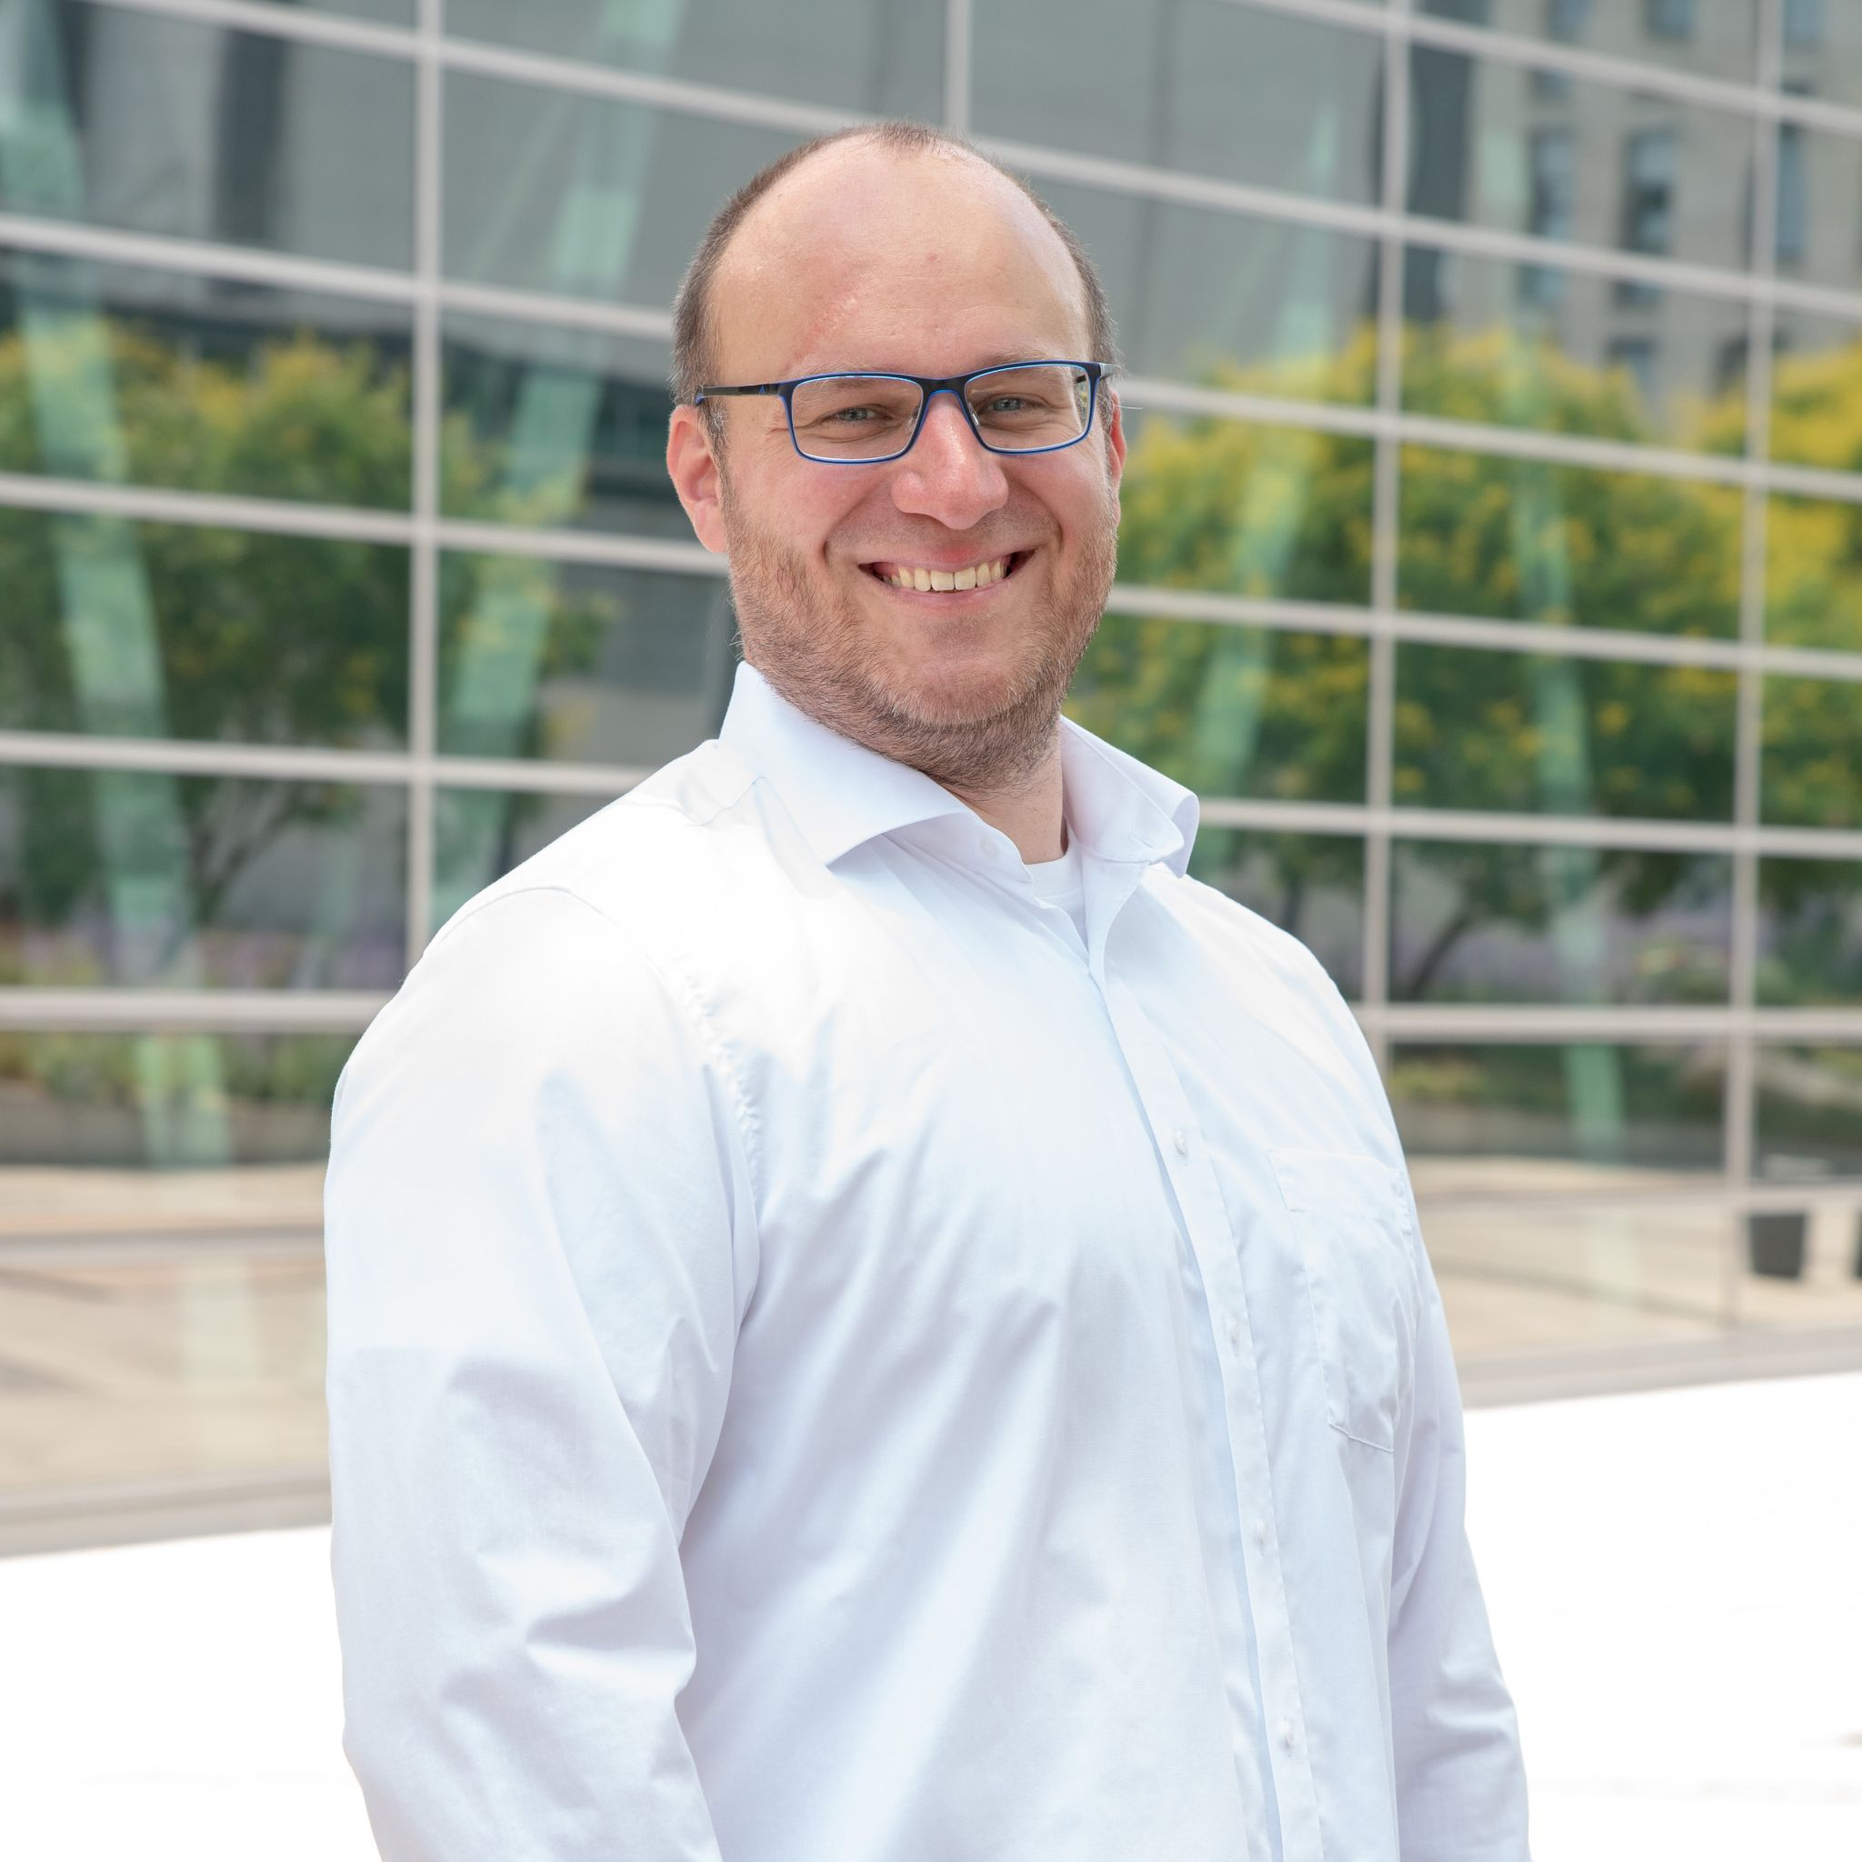
Contact
Tristan Evans Kevin Hermanns
PE-Systems GmbH PE-Systems GmbH
tristan.evans@pe-systems.de kevin.hermanns@pe-systems.de

